Slide 1
JavaScript Fundamentals
Basic of JavaScript
Saurabh Singh (30 Jan 2026)

Slide 2
Learn what JavaScript is and how it runs inside the browser engine.

Slide 3
What Java Script is?
JavaScript is a high-level, interpreted, dynamically typed programming language used to make web pages interactive.
In the browser, JavaScript:
Responds to user actions (clicks, typing, scrolling)
Manipulates HTML and CSS via the DOM
Communicates with servers (fetch / AJAX)
Controls application logic
JavaScript code is executed inside the browser’s JavaScript engine (for example, Chrome uses V8).

Slide 4
Browser Architecture (Big Picture)
A browser has multiple components, but JavaScript mainly interacts with:
JavaScript Engine – executes JS code
Web APIs – browser-provided features (DOM, timers, fetch)
Event Loop – coordinates async execution
Imp: JavaScript itself does NOT handle async tasks. The browser does.

Slide 5
JavaScript Engine Internals
A JavaScript engine has two core parts:
Call Stack
Executes JavaScript line by line
Uses LIFO (Last In, First Out)
Handles only synchronous code Eg: function a() { b(); } function b() { console.log("Hello"); } a(); a() → b() → console.log()

Slide 6
JavaScript Engine Internals
A JavaScript engine has two core part:
Call Back
Heap
Memory area for objects and functions
Used for dynamic allocation
const user = { name: "Alex" };
The object lives in the heap; the reference lives in the stack.

Slide 7
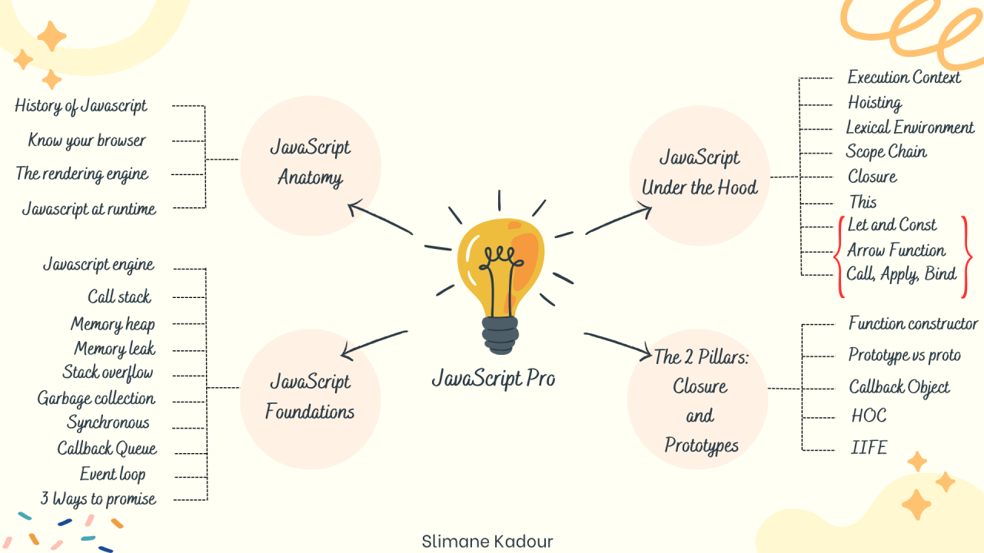

Slide 8
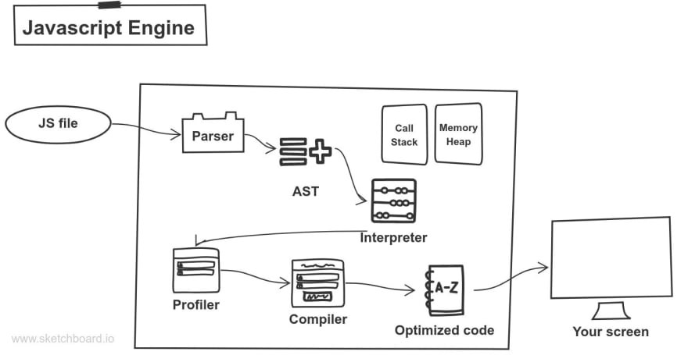

Slide 9
Execution Context (How Code Starts)
Whenever JavaScript runs, it creates an Execution Context.
Types:
Global Execution Context
Function Execution Context
Each context has:
Variable Environment (variables, functions)
Scope Chain
this value
Creation happens in two phases:
Memory Creation(Hoisting)
Execution Phase

Slide 10
Single-Threaded Nature of JavaScript
JavaScript is single-threaded:
One call stack
One thing executed at a time

Slide 11
Web APIs (Browser Power)
The browser provides Web APIs such as:
setTimeout
fetch
DOM events
Geolocation
WebSockets
setTimeout is handled by the browser, not the JS engine.
Eg: setTimeout(() => { console.log("Done"); }, 1000);

Slide 12
Event Loop (The Heart of Async JS)
Step-by-step flow:
JS executes synchronous code in the call stack
Async tasks are sent to Web APIs
When done, callbacks go to:
Microtask Queue (Promises)
Task Queue (setTimeout, events)
Event Loop checks:
Is call stack empty?
If yes → move queued callback to stack
Priority: Microtask Queue > Task Queue

Slide 13
Understanding Execution Order
console.log("A");
setTimeout(() => {
console.log("B");
}, 0);
Promise.resolve().then(() => {
console.log("C");
});
console.log(“D");
(Try it out)

Slide 14
Understanding Execution Order
A D C B
Why?
Sync code first(A,D)
Promises (microtasks) next(C)
Timers (tasks) last(B)

Slide 15
Why This Model MatterS
Helps you:
Avoid UI blocking
Debug async bugs
Write better React code
Answer interviews confidently

Slide 16
Understand JIT compilation, Global Execution Context (GEC), and the call stack basics.

Slide 17
JIT (Just-In-Time) Compilation
What it means
JavaScript is not compiled ahead of time like C or Java.
Instead, it uses Just-In-Time (JIT) compilation. 👉 Code is compiled while it is running.

Slide 18
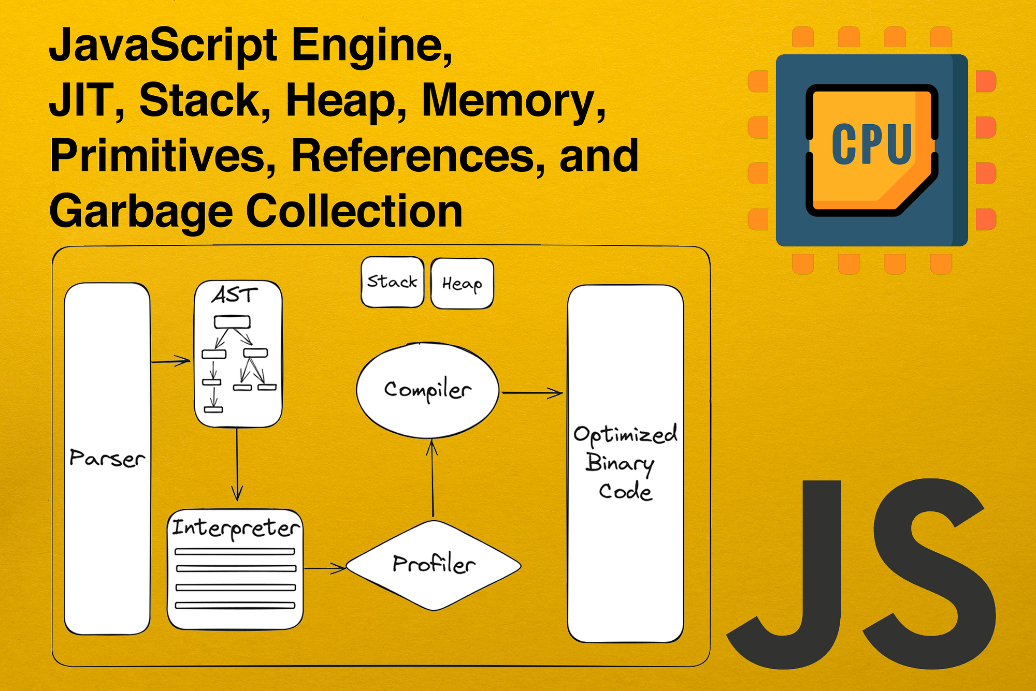

Slide 20
JIT (Just-In-Time) Compilation
How it works (high level)
JavaScript code is read by the engine (V8, SpiderMonkey, etc.)
Code is parsed into an Abstract Syntax Tree (AST)
Code is first interpreted (fast start)
Frequently used code is optimized and compiled to machine code
Slow code may be de-optimized and recompiled

Slide 21
JIT (Just-In-Time) Compilation
Why JIT is important
⚡ Faster execution than pure interpretation
🚀 Optimizes hot (frequently executed) code
🧠 Balances startup speed and performance
KEY TAKEAWAY JavaScript becomes faster as it runs, not before it runs.

Slide 22
Global Execution Context (GEC)
What is an Execution Context
An execution context is an environment where JavaScript code is evaluated and executed.
The Global Execution Context (GEC) is:
Created first
Created only once
Associated with the global code

Slide 23
Global Execution Context (GEC)
Two phases of GEC
Phase 1: Memory Creation Phase
window object is created (in browsers)
this is set to window
Variables are allocated memory (undefined)
Functions are stored entirely
var a = 10; function foo() {}
Memory phase: a -> undefined foo -> function

Slide 24
Global Execution Context (GEC)
Two phases of GEC
Phase 1: Execution Phase
Code runs line by line
Variables get actual values
Functions are executed when called
a-> 10
Key Takeaway: JavaScript allocates memory first, then executes code.

Slide 25
Call Stack (Execution Stack)
What is Call Stack?
The call stack is a data structure that:
Tracks which function is currently running
Uses LIFO (Last In, First Out)
How it Works?
GEC is pushed first
Each function call is pushed on top
When a function finishes , it is popped out

Slide 26
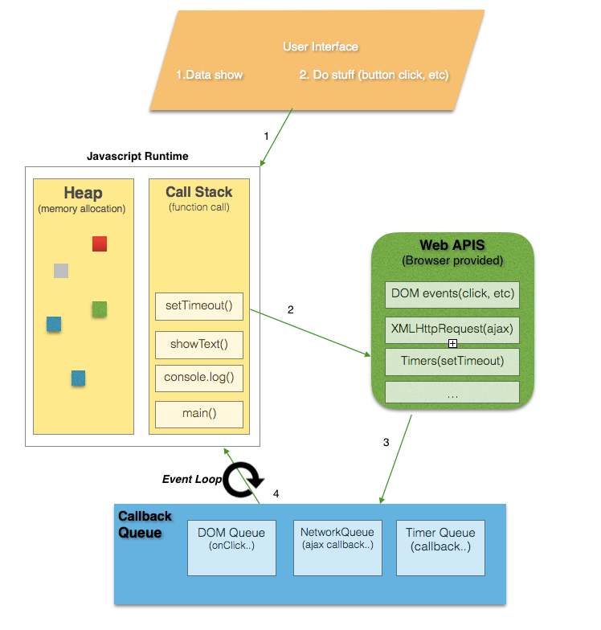

Slide 27
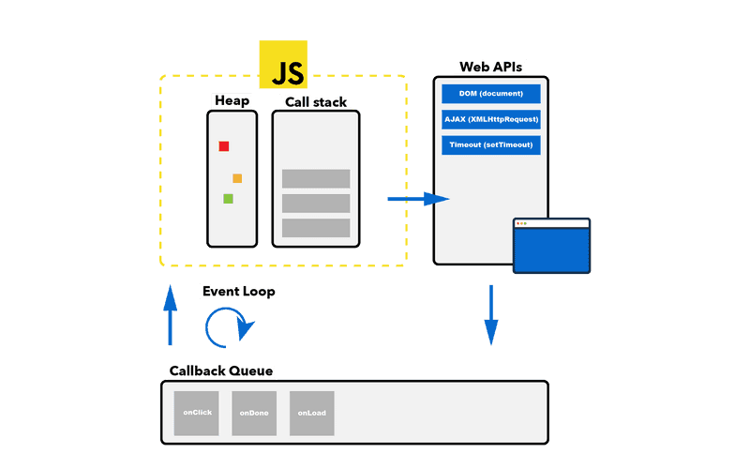

Slide 28
Call Stack (Execution Stack)
function a() {
b();
}
function b() {
c();
}
function c() {
console.log("Hello");
}
a();

Slide 29
Call Stack (Execution Stack)
Stack overflow
If functions keep calling each other endlessly:
function foo() {
foo();
}
foo();
👉 Maximum call stack size exceeded
Key takeaway: JavaScript executes one function at a time, using the call stack.

Slide 30
Call Stack (Execution Stack)
Stack flow:
Global
→ a()
→ b()
→ c()
← c()
← b()
← a()

Slide 31
Work with core data types, operators, and type conversions.

Slide 32
Core Data Types in JavaScript
JavaScript has two broad categories of data types.
Primitive Data Types (stored by value)
Non-Primitive (Refernece) Types

Slide 33
Core Data Types in JavaScript
Primitive Data Types
✔ Primitives are copied by value
let x = 10;
let y = x;
y = 20;
What is value of x?
Type | Example
number | 10, 3.14, NaN, Infinity
string | "hello", 'JS'
boolean | true, false
undefined | variable declared, not assigned
null | intentional empty value
symbol | Symbol("id")
bigint | 12345678901234567890n

Slide 34
Core Data Types in JavaScript
Non-Primitive Data Types
✔ Objects are copied by reference
let a = { value: 10 };
let b = a;
b.value = 20;
//What is value of a.value?
Type | Example
object | { name: “JS” }
array | [1, 2, 3]
function | function foo() {}

Slide 35
Operators in JavaScript
Operators are symbols used to perform operations on values.
Arithmetic Operators
Assignment Operators
Comparison Operators
Logical Operators
Unary & Ternary Operators

Slide 36
Type Conversion(Very Important)
JavaScript automatically converts types in many situations.
Implicit Type Conversion(Type Coercion)
+ prefers string
Other operators prefer number
Explicit Type Conversion(Recommended)
Convert to Number{ parseInt(“10px") }
Convert to String{ (10).toString() }
Convert to Boolean{ Boolean (“JS”) }

Slide 37
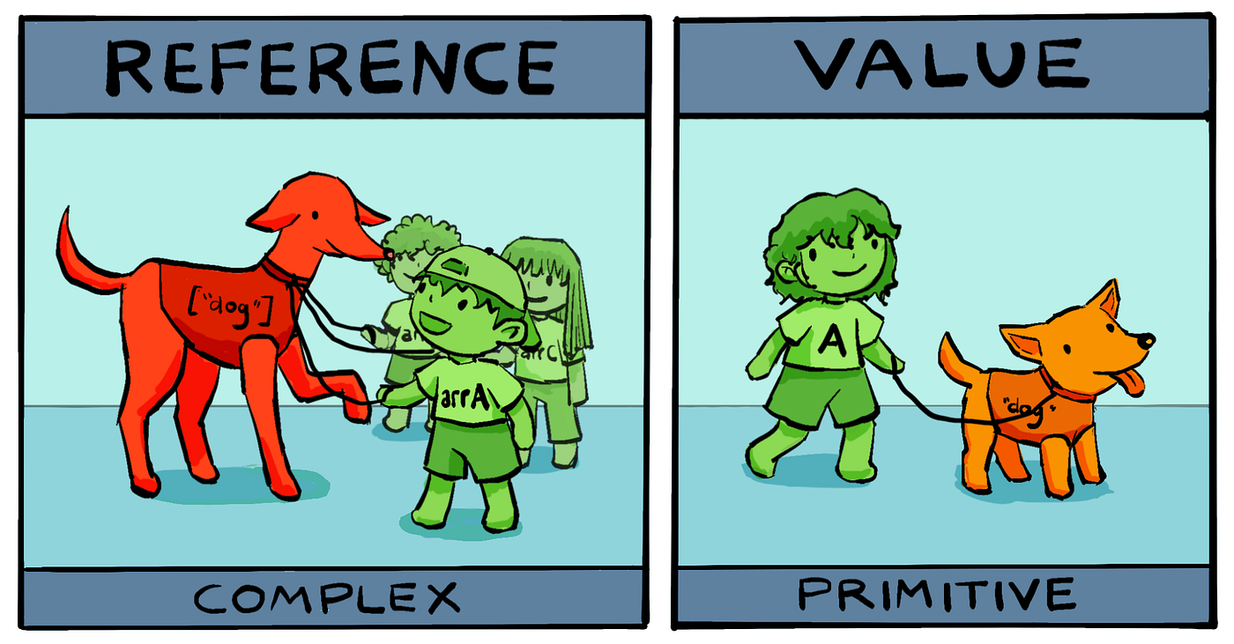

Slide 39
Compare var, let, and const, and understand how scope rules affect your code.

Slide 40
Why JavaScript Needed let and const
Early JavaScript had only var. This caused silent bugs due to:
No block scope
Accidental re-declarations
Global variable pollution
Unexpected behavior in async code
ES6 (let and const) was introduced to make JavaScript:
More predictable
More maintainable
Safer for large applications

Slide 41
Scope Types in JavaScript (Foundation)
JavaScript has three main scope types:
1️⃣ Global Scope
2️⃣ Function Scope
3️⃣ Block Scope
Understanding which keyword maps to which scope is critical

Slide 42
var function
A var variable is scoped only to the nearest function, not blocks.
Example: function example() { if (true) { var x = 10; } console.log(x); // 10 }
Even though x is inside if, it belongs to the entire function.
Consequences: Consequence
Blocks(if , for, while) do not protect variables declared with var.

Slide 43
let and scope- True Block Scope
Definition
Variables exist only inside the nearest {} block
if(true) { let a = 5; const b = 6; } what will happen here?

Slide 44
let and scope- True Block Scope
Why this matters?
Block Scope:
Prevents accidental overwrites
Keeps variables close to usage
Makes reasoning about code easier

Slide 45
Execution Context & Hoisting (Under the Hood)
JavaScript Execution Phases
Every scope goes through
Memory creation phase
Execution phase

Slide 46
Execution Context & Hoisting (Under the Hood)
var Hoisting(Memory Phase)
console.log(x); // undefined var x = 10;
Memory phase: x = undefined
Execution phase: x = 10;
➡️ No error, but logic bugs happen silently.

Slide 47
Execution Context & Hoisting (Under the Hood)
Let/const Hoisting(Temporal Dead Zone)
console.log(y); // ReferenceError let y = 10;
Variable exists in memory
But cannot be accessed
TDZ lasts until declaration line
➡️ Forces correct order of code.

Slide 48
Temporal Dead Zone (TDZ) — Why It Exists
TDZ prevents this: let total = total + 1; // ❌ ReferenceError
Without TDZ:
Bugs would silently propagate
Debugging becomes difficult
TDZ enforces : “Declare before use”

Slide 49
Re-declaration — Silent Bug vs Compile-Time E
var
var user = “Alice”; var user = “Bob”;
➡️ No warning, value overwritten.

Slide 50
Re-declaration — Silent Bug vs Compile-Time E
let/const
let user = “Alice”; let user = “Bob”;
➡️ Caught early during development.

Slide 51
Re-assignment vs Mutation (Very Common Confusion)
const prevents reassignment, not mutation const obj = { count: 1} obj.const = 2; //allowed
But obj = {}; //error
Why?
Reference is constant
Internal data may change

Slide 52
Loop Scope & Async Behavior (Critical Concept)
var shares one binding
for(var i = 0; i < 3; i ++){ setTimeout(() => console.log(i ), 1000); }
What will be the output? And Why?

Slide 54
Loop Scope & Async Behavior (Critical Concept)
let creates a new binding per iteration
for(var i = 0; i < 3; i ++){ setTimeout(() => console.log(i ), 1000); }
What will be the output? And Why?

Slide 55
Loop Scope & Async Behavior (Critical Concept)
for(var i = 0; i < 3; i ++){ setTimeout(() => console.log(i ), 1000); }
Output:
in case of var 3 3 3 why? one shared i Callback runs after loop finishes
Incase of let 0 1 2 Each iteration gets its own scope.

Slide 56
Scope Chain & Shadowing
Variable Shadowing
let value = 10; { let value = 20; console.log(value); //20 } console.log(value); //10
Inner value shadows outer value
Rules:
Inner scope can access outer
Outer cannot access inner

Slide 57
Global Scope & Pollution
var x = 10; var y = 20;
Browser: window.x //10 window.y //undefined
Problems with var globals
Name collisions
Security risks
Hard-to-debug bugs

Slide 58
Why const Is Preferred by Default
Using const:
Documents intent
Prevents accidental reassignment
Improves readability
Makes refactoring safer
Industry rule: “Use const unless you know you need let”
let and const introduce block scoping and the temporal dead zone, eliminating entire classes of bugs caused by hoisting, redeclaration, and shared bindings that existed with var”

Slide 59
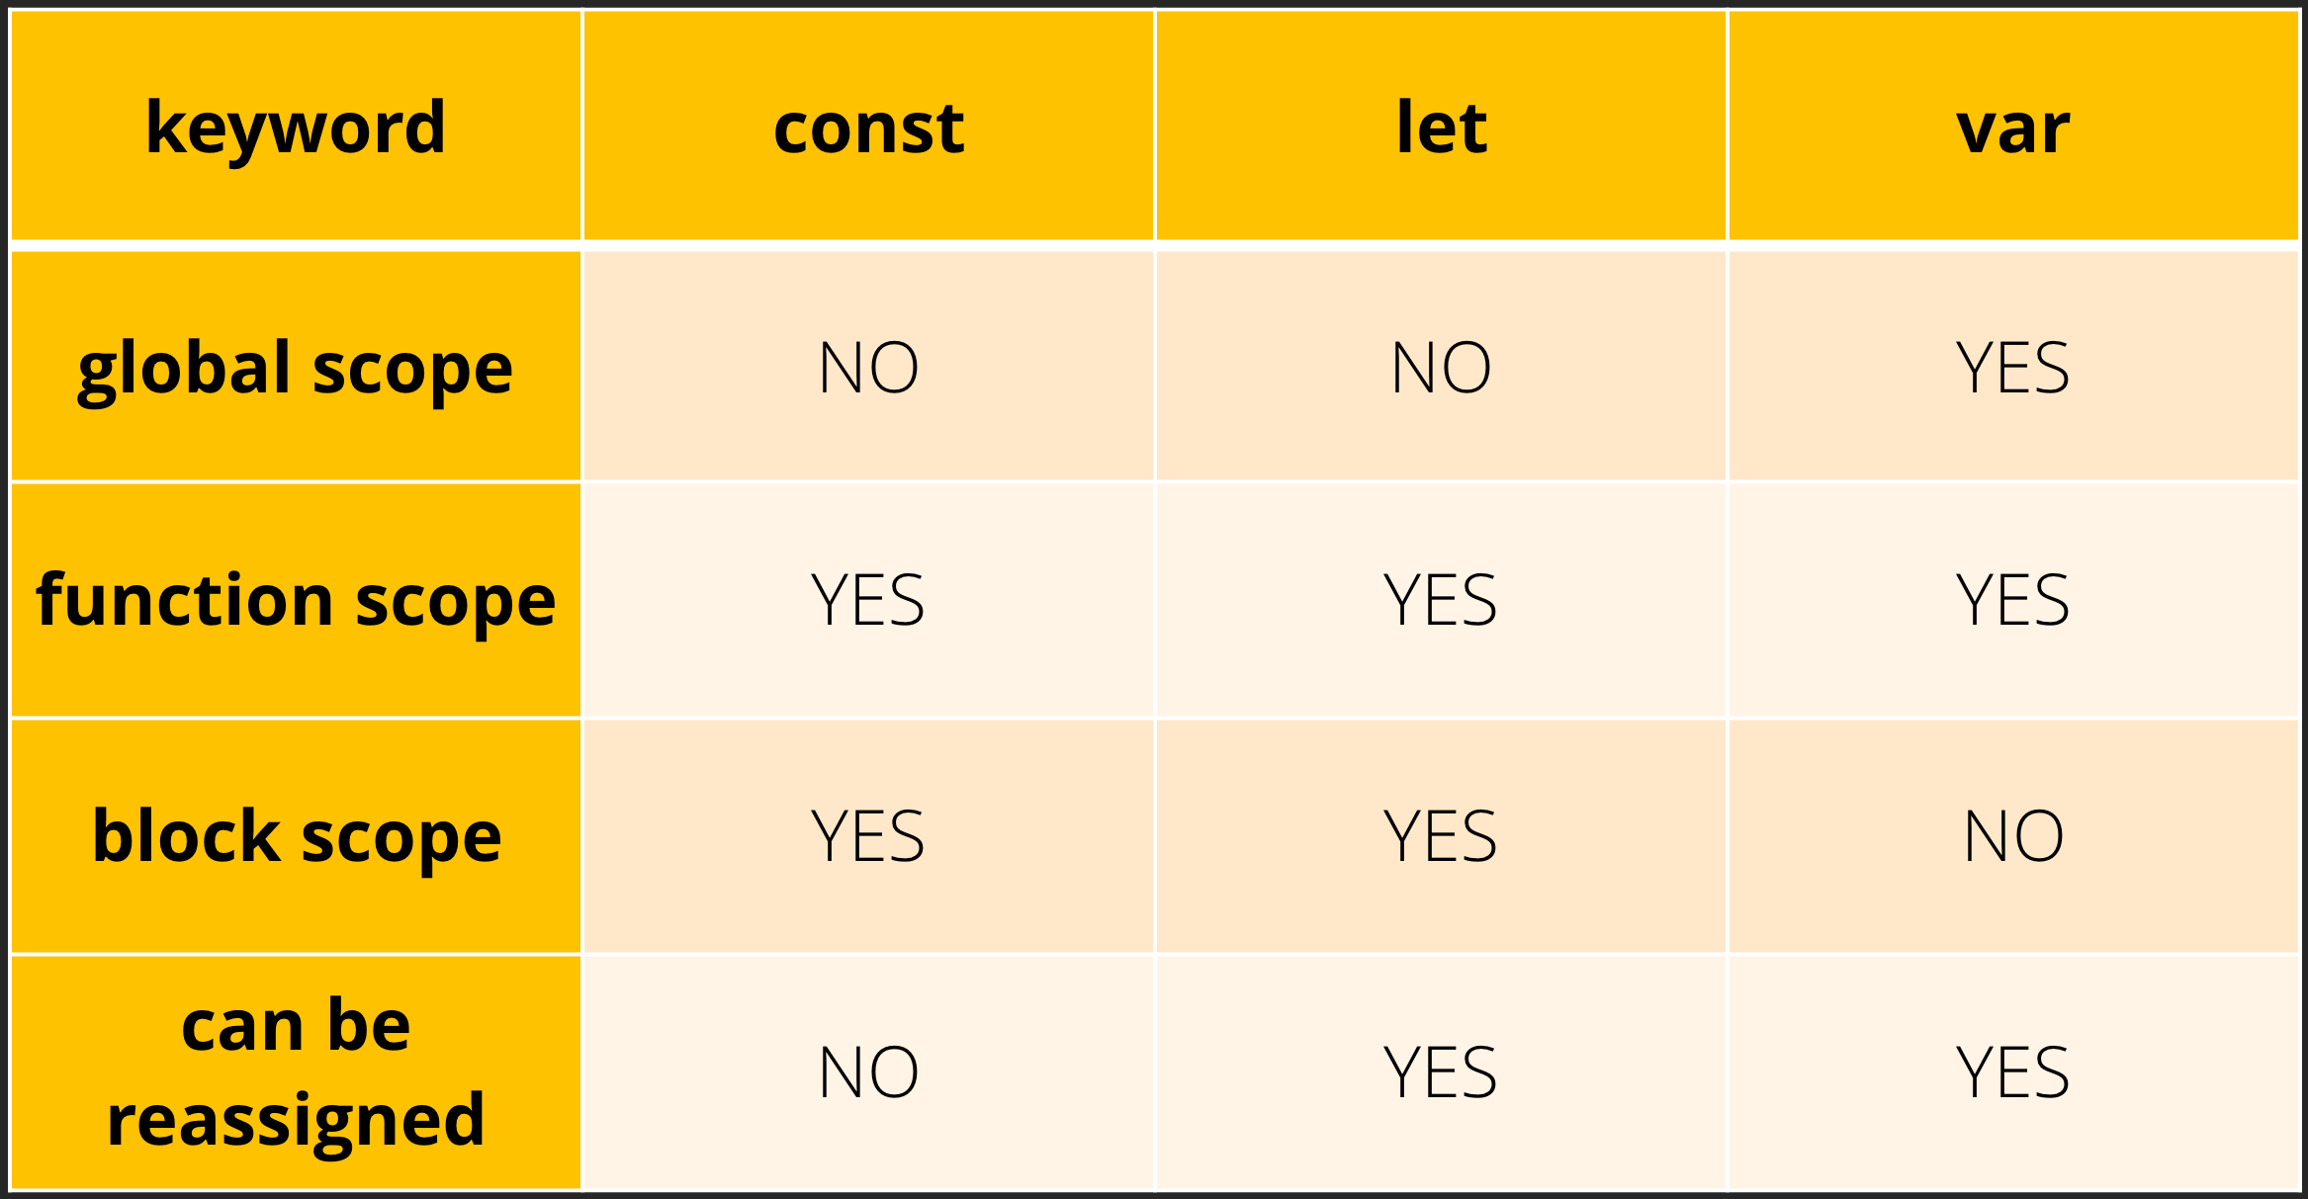

Slide 60
AI-generated explanations of call-stack execution

Slide 61
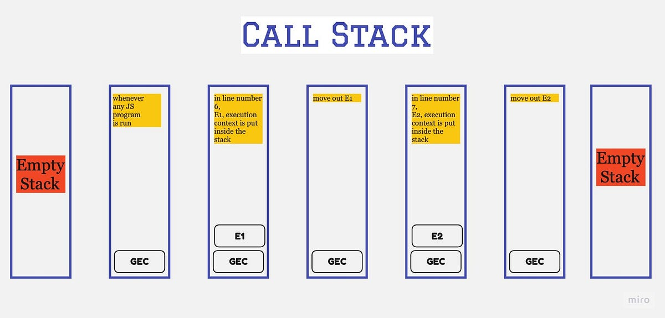

Slide 62
What the call stack is
The call stack is a LIFO (Last-In, First-Out) data structure used by a runtime (browser, Node.js, JVM, etc.) to track which function is currently executing and where to return next.
Each entry in the stack is a stack frame, which contains:
Function name
Local variables
Parameters
Return address (where execution resumes)

Slide 63
How execution works
function A() { B(); } function B() { C(); } function C() { console.log("Hello"); } A();

Slide 64
How execution works
Execution flow
Global context is pushed
A() is called → push A
A() calls B() → push B
B() calls C() → push C
C() finishes → pop C
B() finishes → pop B
A() finishes → pop A
Stack returns to global
Stack state (top → bottom)

Slide 65
How execution works
C() B() A() Global
After C() returns: B() A() Global

Slide 66
Why the call stack matters
1. Debugging
Stack traces show the exact chain of calls
Helps identify where an error originated
2. Performance
Deep recursion → large stack → risk of stack overflow
Each function call has memory cost
3. Language behavior
Explains why synchronous code blocks execution
Explains execution order precisely

Slide 67
Common pitfalls explained by the call stack
❌ Stack Overflow function recurse() { recurse(); } recurse();
No base case -> infinite calls -> stack memory exhausted

Slide 68
Common pitfalls explained by the call stack
❌ Blocking Execution while (true) {}
The call stack never clears -> browser freezes

Slide 69
Call stack vs async code (important distinction)
The call stack handles only synchronous code.
console.log("A"); setTimeout(() => { console.log("B"); }, 0); console.log(“C");
Execution Order A C B

Slide 70
Call stack vs async code (important distinction)
Why?
setTimeout callback is not published immediately
It goes to callback queue
Executed only after the call stack is empty
(Call stack + Web APIs + Task Queue = Event Loop)

Slide 71
Debugging JS issues using Cursor

Slide 72
Debug Set 1 — Silent Logic Bugs (Pure JS)
Bug 1: Condition Always Passes function canEdit(user) { if (user.role === "admin" || "editor") { return true; } return false; } console.log(canEdit({ role: "guest" })); // ❌ true Ask cursor: “Explain why this condition always evaluates to true.”
Bug 2: Incorrect Comparison function isAdult(age) { return age > 18 == true; } console.log(isAdult(17)); // ❌ true
Ask cursor: “Evaluate operator precedence step by step.”

